Slide 1


AST21118
Engineering Project Development
Group – 1 (Task 2)

Slide 2
Group Details
Kao Fung Ting: Hardware Configuration & Troubleshooting + Testing
Lee Long To: Led SLAM Configuration, Localization, and Mapping
Shadev Kharel: System Integrator and Core Dev For Text_Nav System(TTS)
Lee Chung Wing: RViz Visualization and Overall Testing Coordinator
Wang Yicheng: Documentation and Workflow Management.

Slide 3
Task Requirements
Mapping using SLAM
Point to Point Navigation
Obstacle Detection
Microphone Based
Input + Feedback

Slide 4
Task Success
Mapping Using SLAM ✅
Point to Point Navigation ✅
Obstacle Detection ✅
Voice Input / Speaker Feedback❌
→ Rescaled to Basic Text Input / Speaker Feedback ✅

Slide 5
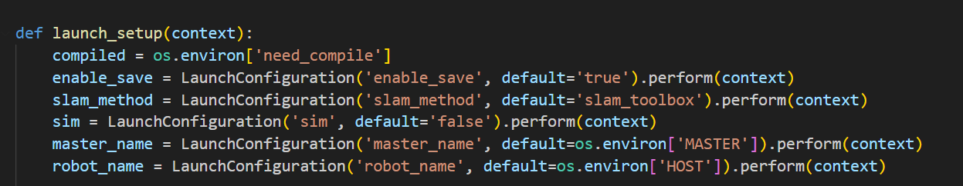
Mapping Using SLAM
Uses SLAM_Toolbox, and Launch_setup launches robot_base, robot_links, and utilizes slam.YAML tailored for various topics like /scan, /map.
Physical Location vs Map in next slide

Slide 6
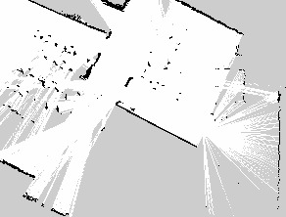
Noisy Map Problem
Initial Attempt: Space in 2/F, between two rooms
Large Open Areas Caused LiDAR to misinterpret distances
Also, the glass surfaces led to inaccurate reflections
Therefore, due to inaccuracy in mapping, we couldn’t find the robot’s initial pose.
We changed the location to an enclosed dance room in 3/F.

Slide 7
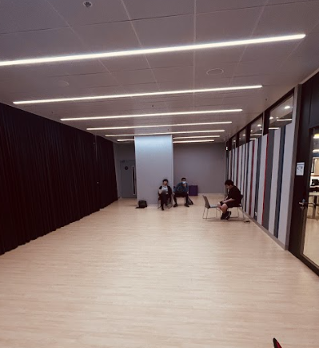
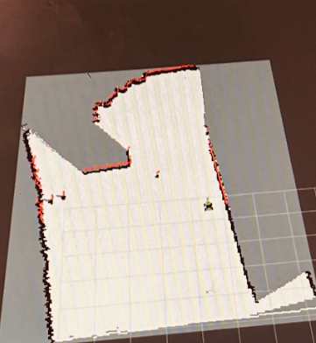

Slide 8
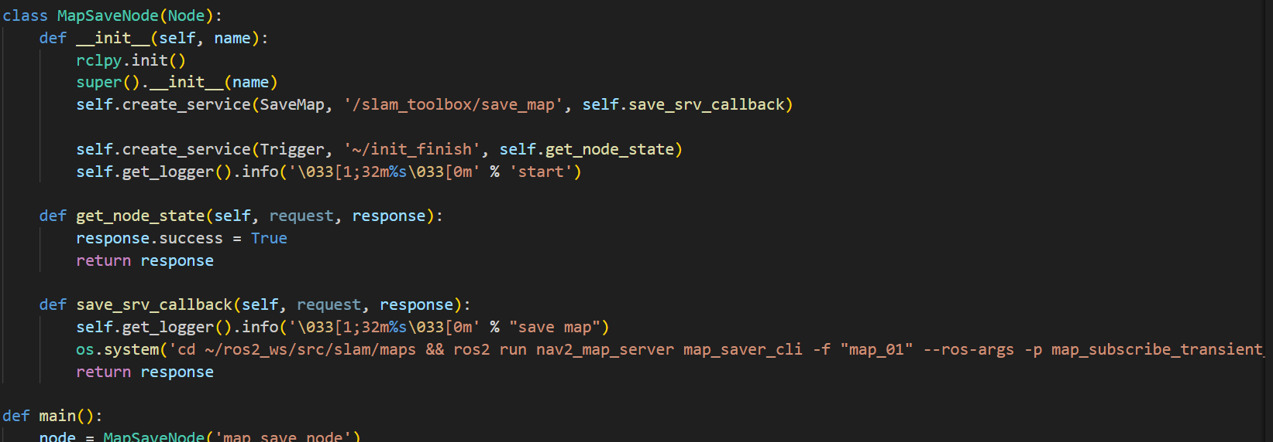
Map Saving Node
Initializes a MapSaveNode and calls the SaveMap Service of SLAM Toolbox.
When the save_map service is called, it runs a shell command that uses map_server_cli.
Then, saves map to the directory /ros2_ws/src/slam.

Slide 9
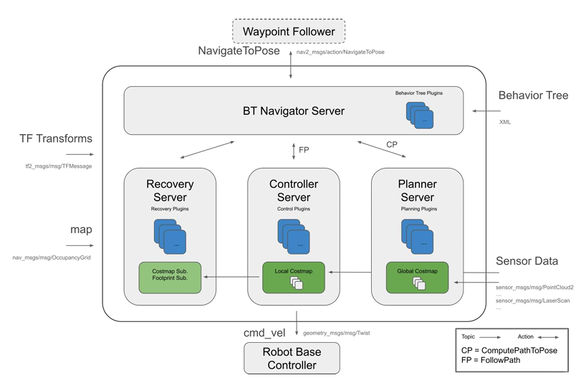
Navigation using NAV2

Slide 10
Trial of Text_Nav Custom Package
Tested in House Premise
Added Two Points: one “door” and another “eating”
The text_nav node was launched with map_house SLAM Map.
When command ros2 topic pub/std_msgs:String “data: ‘door’” was inputted via. command line.
The Robot moved from its original position to the door as specified in the log input data.

Slide 11
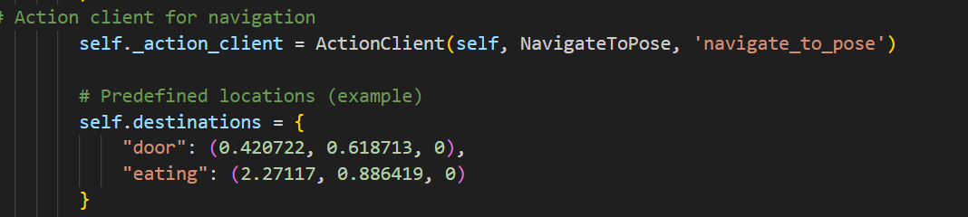
Text Based Navigation and Basic HRI
Specify and Hardcode the Coordinates of two points in the map.
Convert Euler (X,Y,Z) to Quaternion Form
Send Navigation Goal via. Text in another terminal using ros2 topic pub cmd
The text_nav node takes the command → converts to quaternion→ send to NavtoPose Server → BT Navigator

Slide 12
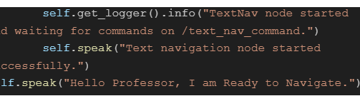
Speaker Utilization
Use of ESPEAK TTS Python Module
Import OS and let the system use default speaker we bought from third party store and manually wired to the Jetrover as a part of Secondary Development.

Slide 13
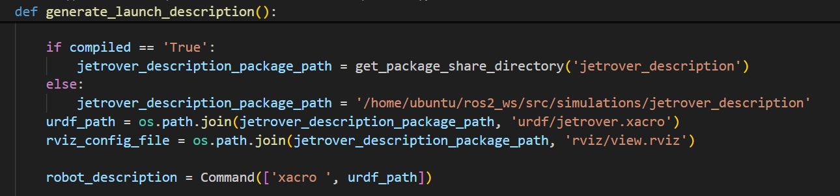
Simulations(RVIZ)
The robot description launch file is invoked everytime we use SLAM or Mapping
The view.rviz and XACRO files defines all the joints, the robot base, and links for the Jetrover
Therefore, in RViZ, the same RobotModel is used which jetrover.xacro has defined inside the /urdf directory.
The URDF and view.rviz were preconfigured by Hiwonder itself.

Slide 14
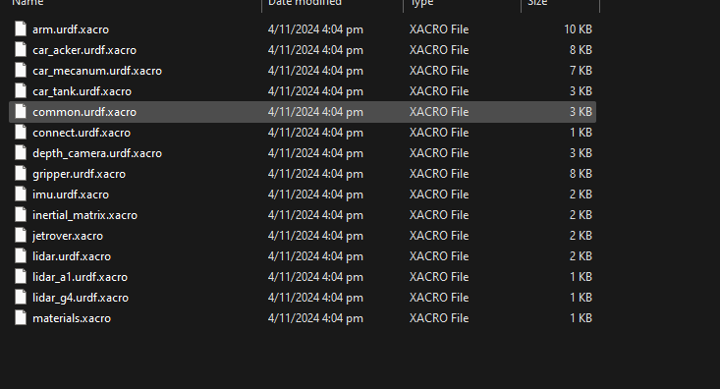
Simulations File Structure
Xacro & URDF Files for Gazebo Simulation
Includes Each Links and Joints of the Jetrover, For example: lidar_a1, arm, and mecanum chassis
Inside the /jetrover_description/urdf directory of ros2_ws / github repo

Slide 15
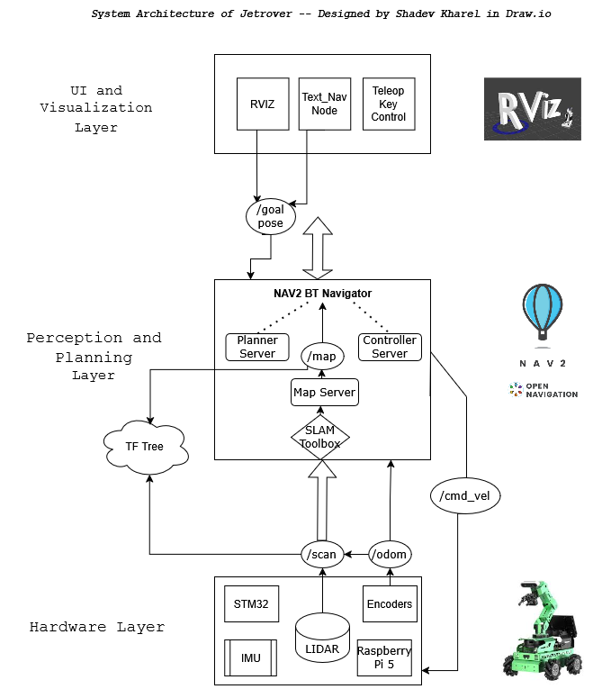

Slide 16
Failures and Learnings
Lidar Error: Error Code: 80008004, (Communication Failure)
Fix:
i. Re-flash the System Image
ii. Change Baud Rate in Hiwonder’s Configuration
iii. Re-wire everything(USB tty, and give sudo command for that port)

Slide 17
Failures and Learnings
Failure to Integrate Microphone :
Cause:
1. Time Constraints
2. PocketSphinx or Google Speech to Text has a deep learning curve
3. No Prior Experience in TTS models

Slide 18
Failures and Learnings
Learnings:
Basic of ROS2 Topics, Nodes, Structure and Configuration.
NAV2, SLAM Toolbox, and RVIZ Functionalities
PEAP Network Connection for UBUNTU-based Raspberry Pi 5 Module
4. Soft Skills:
Communication,
Time Management
Conflict Resolution

Slide 19

THE END
Thank You

